Slide 1
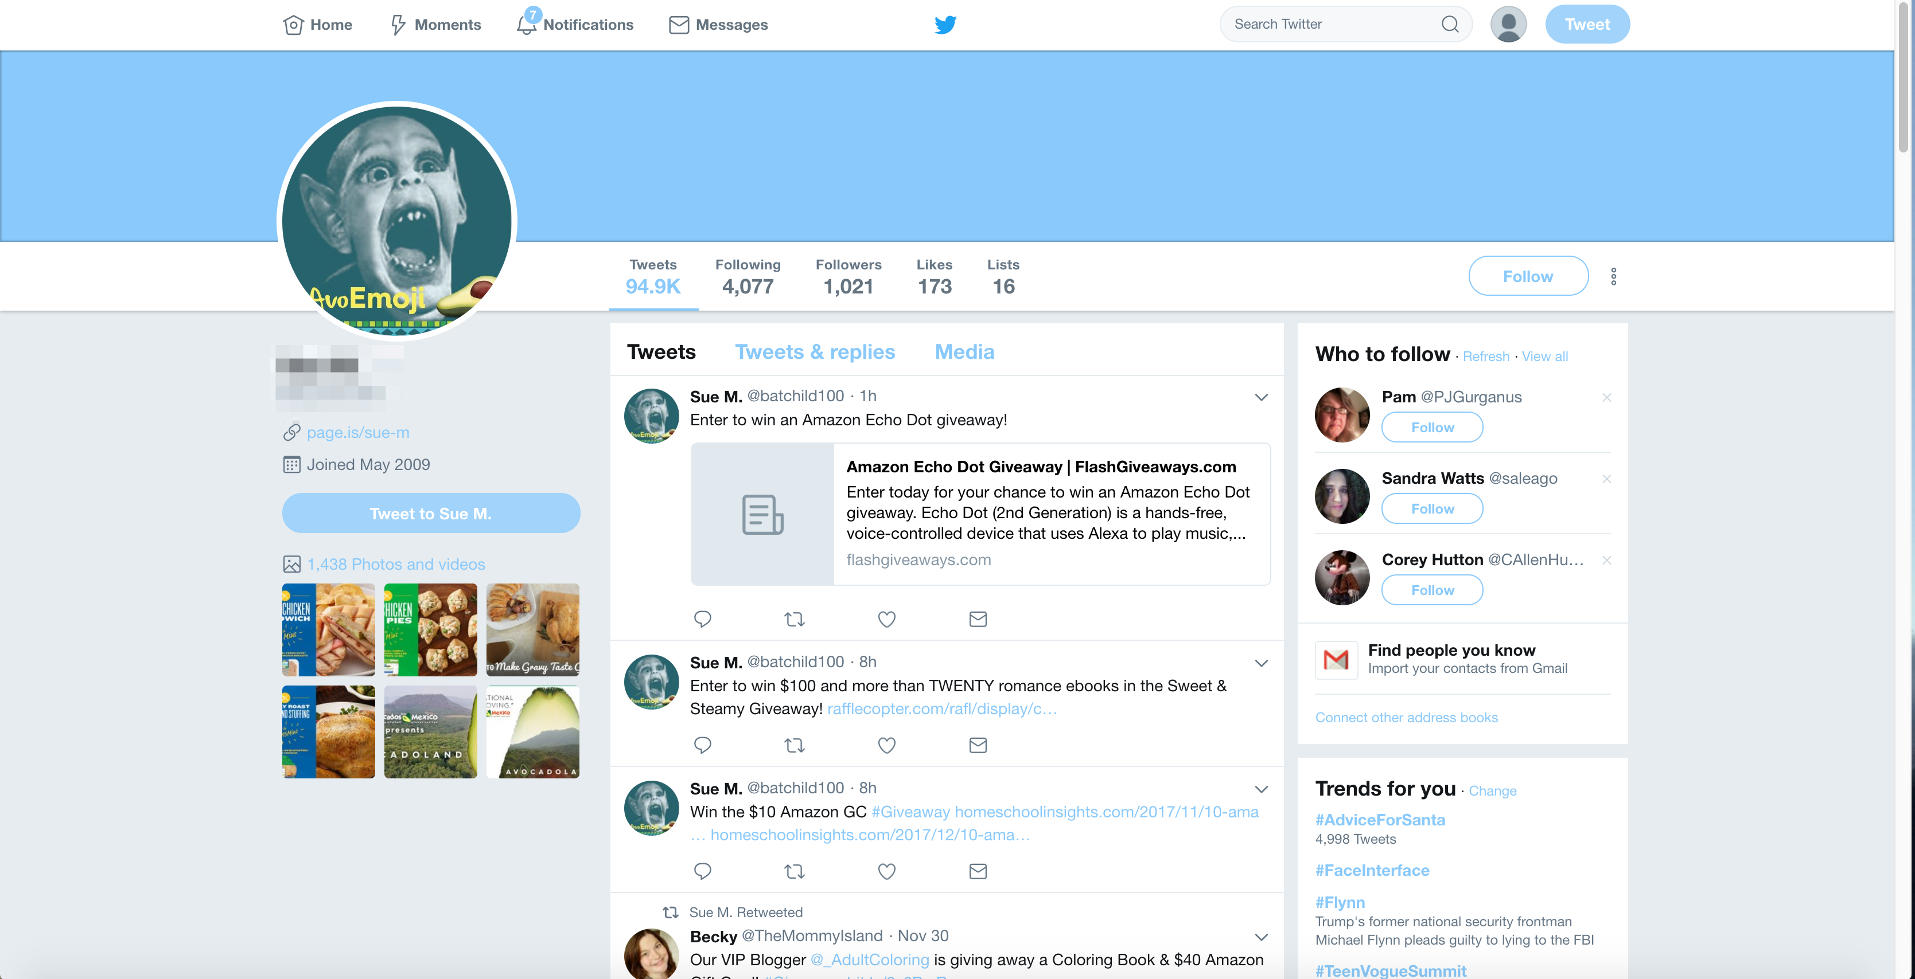

There is a 92% chance that this user is a bot
Dismiss
Learn more
Report user

Slide 2
There is a 92% chance that this user is a bot
Dismiss
Learn more
Report user

Slide 4
Dismiss
There is a 92% chance this user is a bot
Learn more
Report user

Slide 5
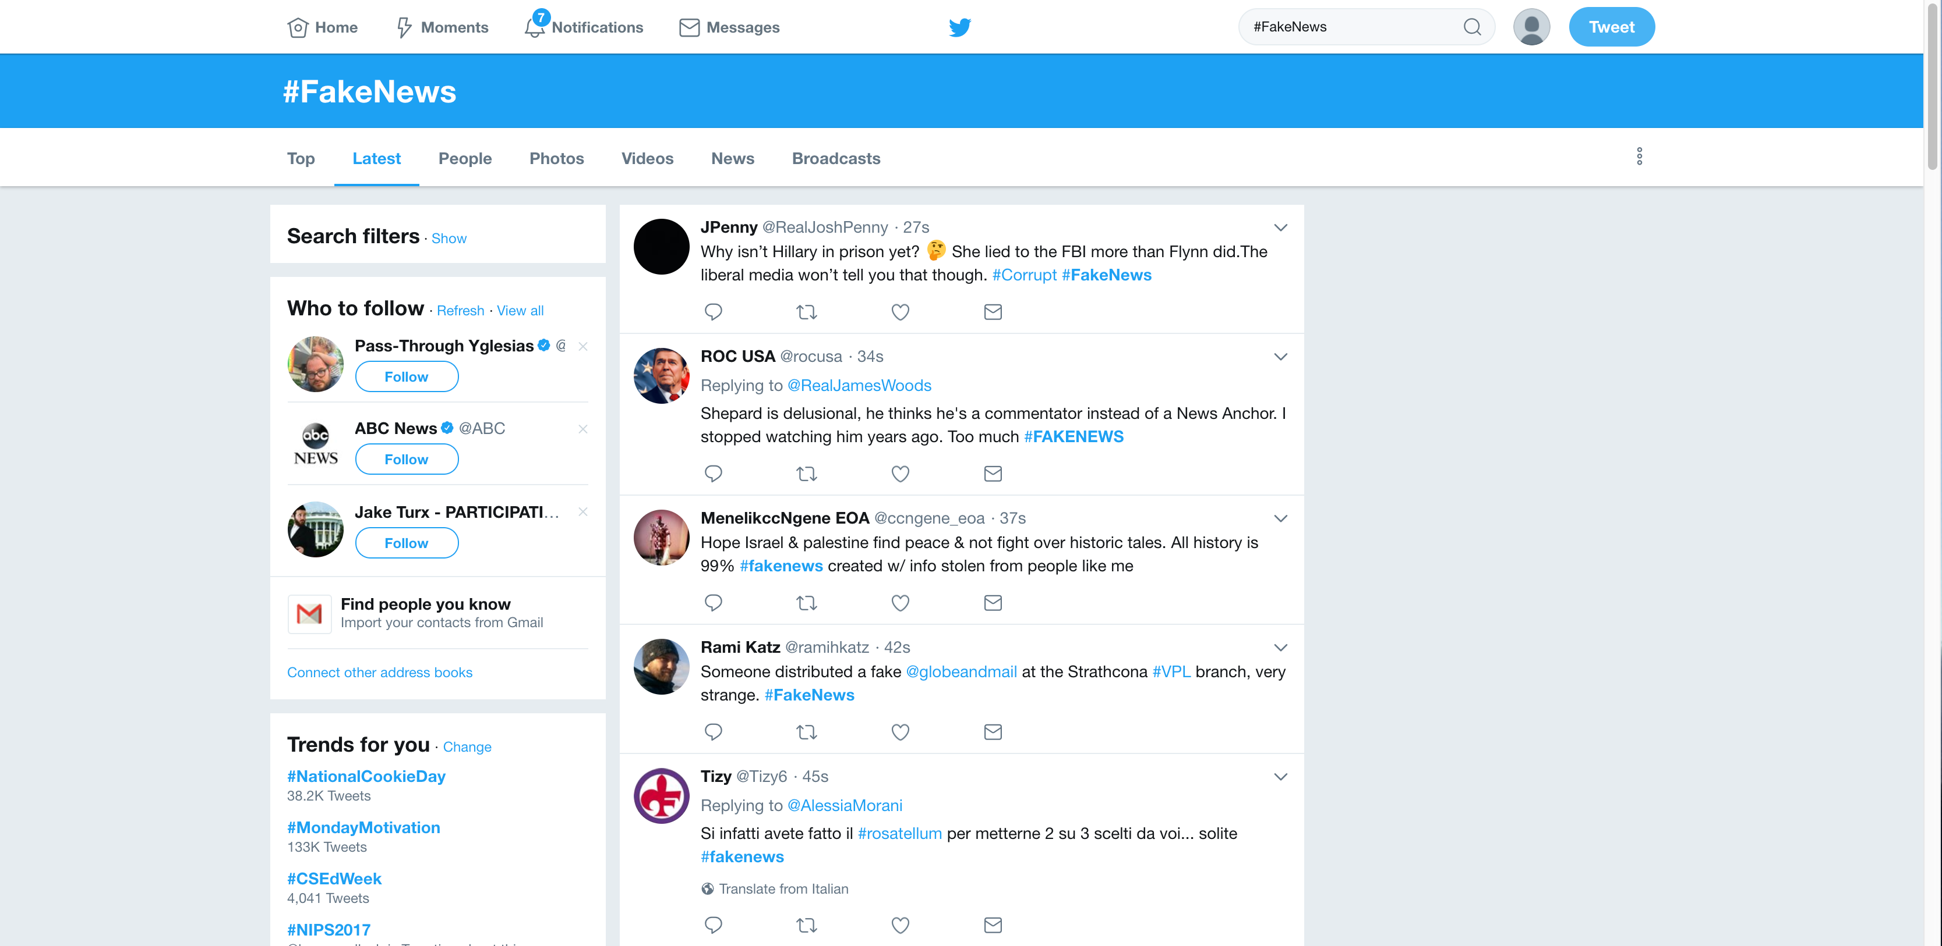

Slide 7
Dismiss
There is a 70% chance this user is a bot
Learn more
Report user

